Slide 1
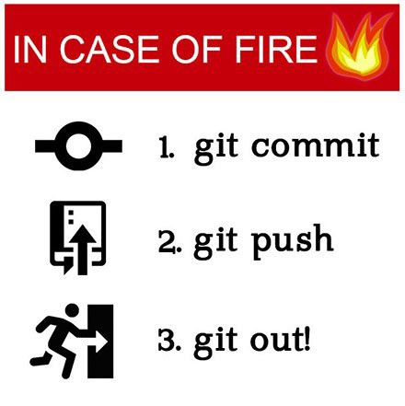
BootUp – Git/GitHub

Slide 2
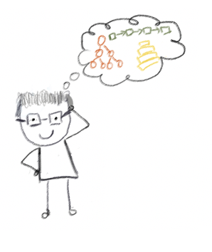


Lecturer
Peng Du
High performance computing
Matrix stuff, Matrix Factorization, etc
Cloud & Edge computing
Kubernetes, docker, etc.
Part-time Teaching
CSS 342
CSS 143
pengdu@uw.edu
Peng Du #6018

Slide 3
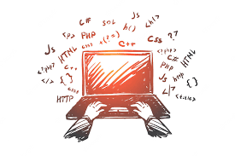
Code & Docs
https://github.com/a-teaching-goose/uwb-bootup/tree/main/docs

Slide 4

Agenda
ACT I: Baby Steps
Why source control?
Git Basics
Commits
Branches
GitHub Repository
Push, pull, rebase
Local vs Remote
ACT II: Advanced Topics
Collaboration
Pull Request
Merge
Continuous Development
CI & CD

Slide 5
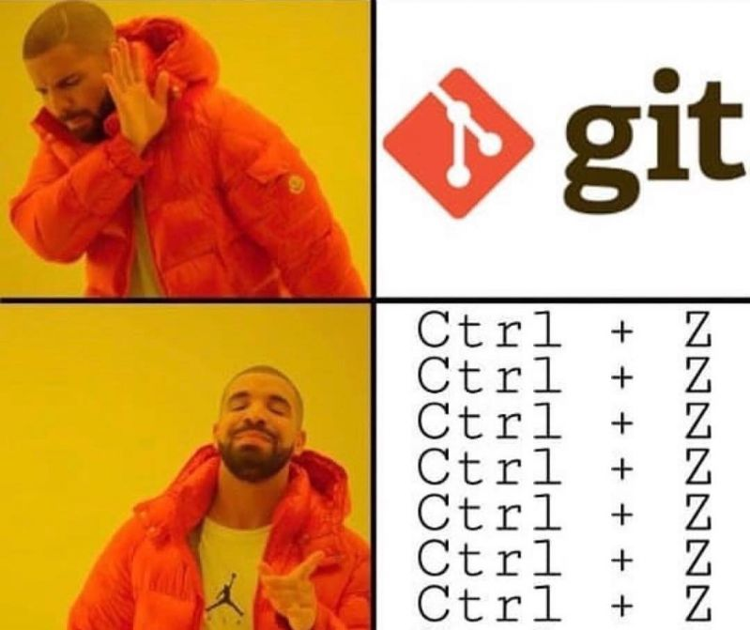

ACT I: Baby Steps
Why source control?
Git Basics
Commits
Branches
GitHub Repository
Push, pull, rebase
Local vs Remote

Slide 6

Who ate your homework?
“My laptop crashed last night, and my homework is gone”

Slide 7
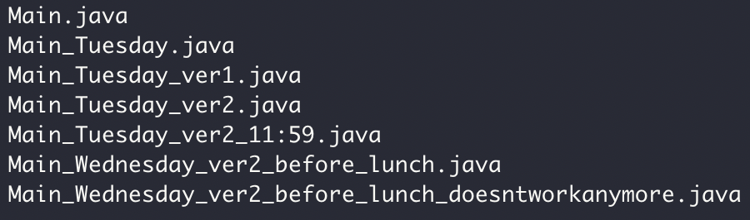

Versions, so many versions

Slide 8
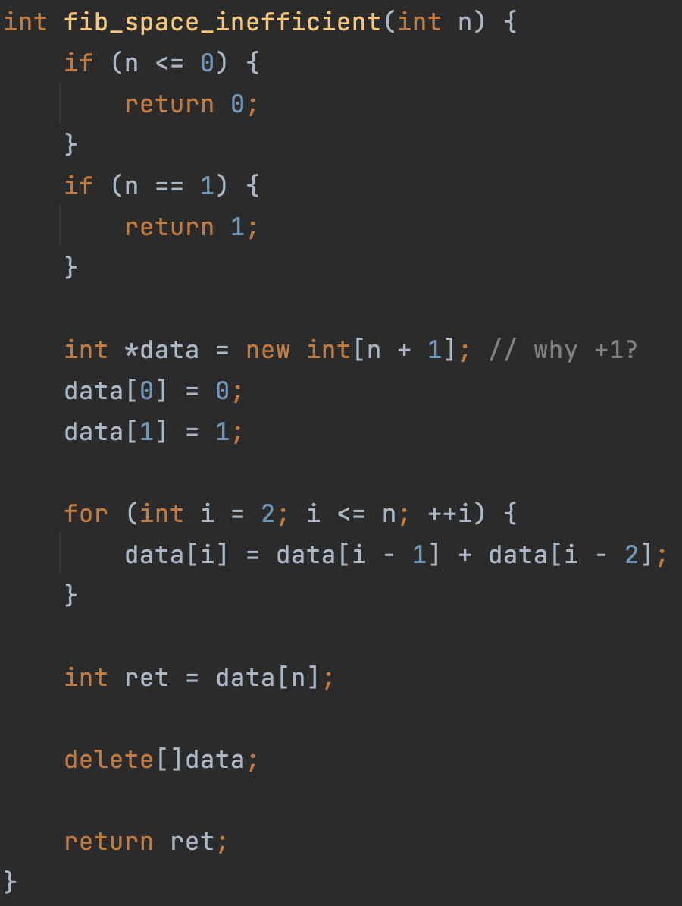
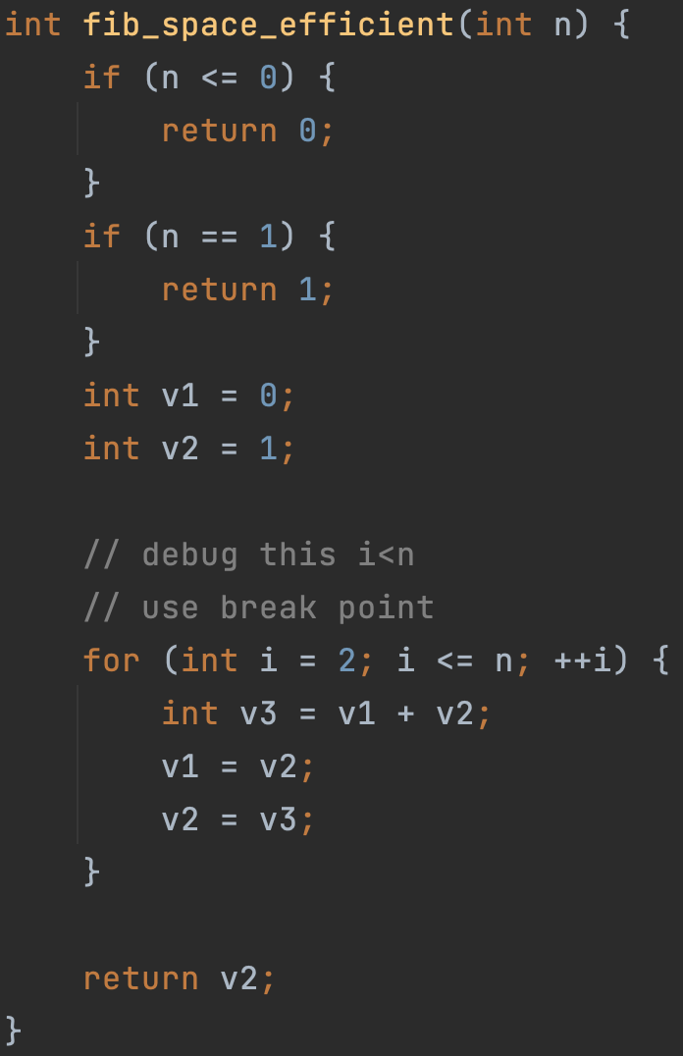

Source Control
Manage Changes
Version 1
Version 2
… …
Monday
Tuesday
Wednesday
Thursday

Slide 9

Why Git and GitHub
Widely used in industry and open-source projects
Easy to track progress (commits)
Easy to track features (branch)
Easy to collaborate with others (GitHub)

Slide 10

Source Control
“commits”
Code version 1
Code version 2
Code version 3
Code
……
Your computer
Monday
Tuesday
Wednesday
Thursday
Time

Slide 11

Code commit 1,2
Code commit 3
Code commit 4,5,6
Code
commit 1
commit 2
Code
commit 3
Code
commit 4
commit 5
commit 6
Code
……
Your computer
Time

Slide 12
Source Control:
Commit 1
Commit 2
Commit 3
Commit 6
Commit 7
Time

Slide 13



Git/GitHub Terms
Repository, or “Repo”
Collection files from a project
Commit
A snapshot of the repo at the certain time
Branch
A line of development, consisting of a series of commits

Slide 14
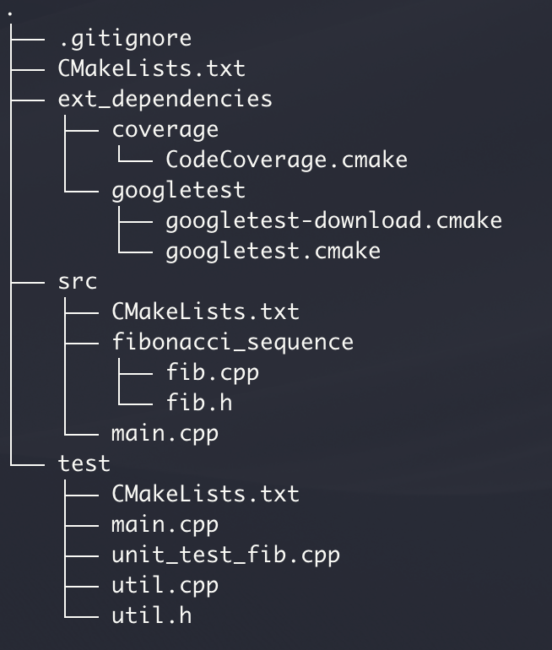
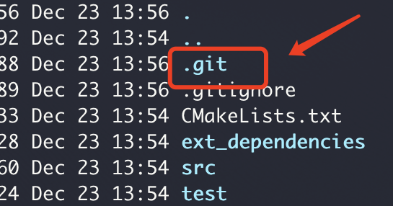

Find the start code here
1
Project folder
Git Repo
git init
“Hey Git! Manage this folder as a repo(sitory)!”
git add .
“Hey Git! Add all the files here to this repo”
git commit -am "my first commit"
“Hey Git! Make a commit (snapshot) of the repo”
“And use a commit message ’my first commit’”

Slide 15

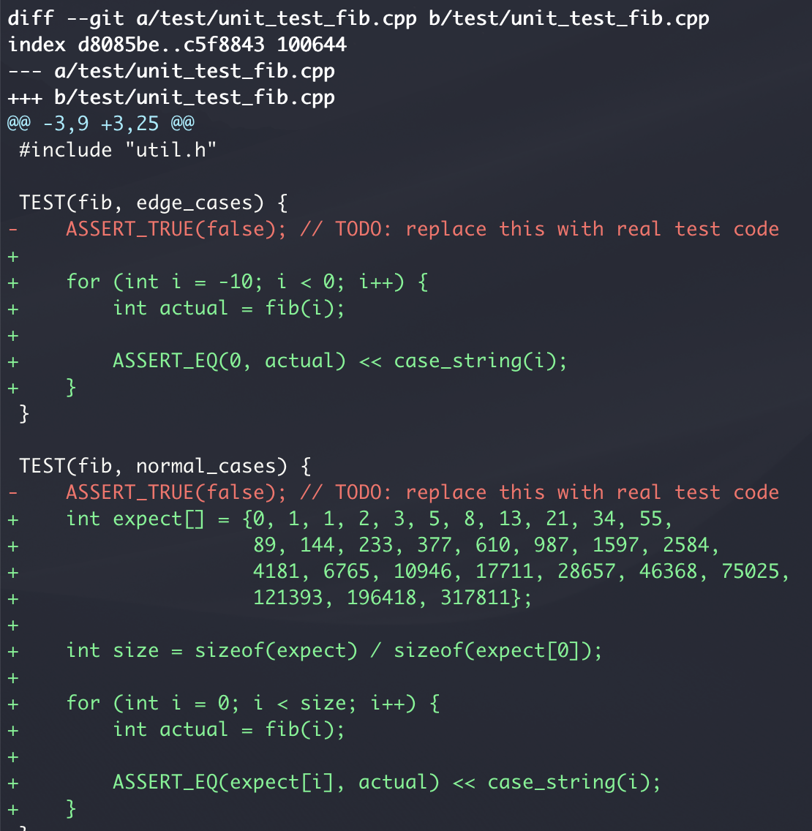
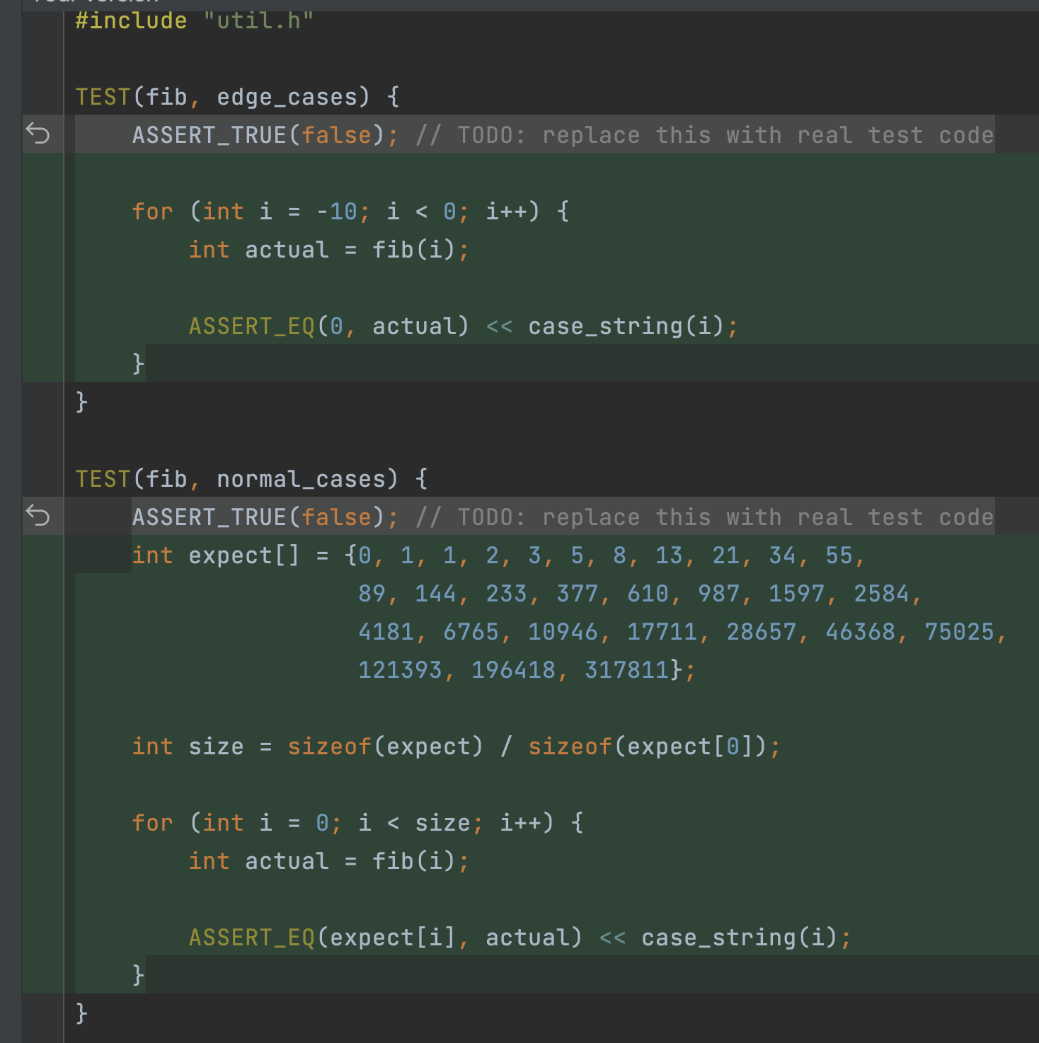
Add unit tests
2
git diff
“Hey Git! Show me what’s changed but not committed since the last commit”
result in command line
result in IDE (CLion)

Slide 16
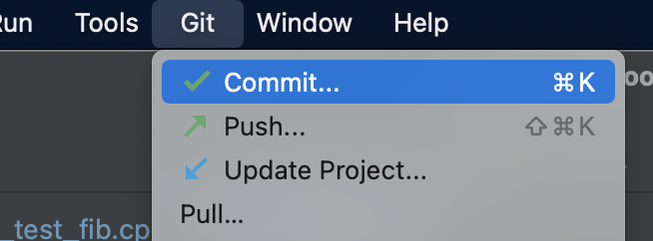
3
git commit -am “add unit tests"
from in command line
from IDE (CLion)
“Hey Git! Commit with message ’add unit tests’”

Slide 17
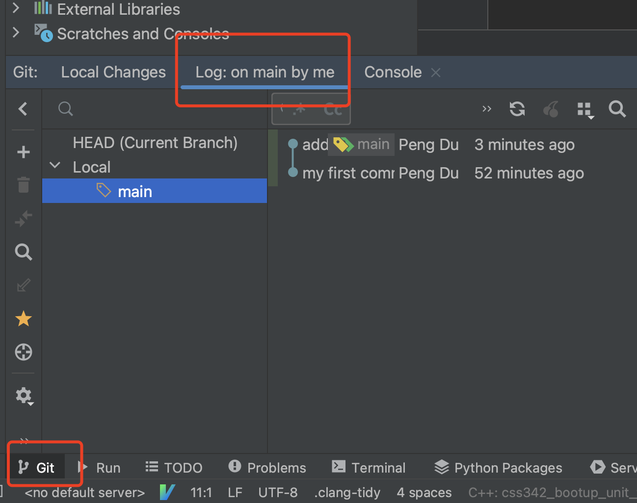
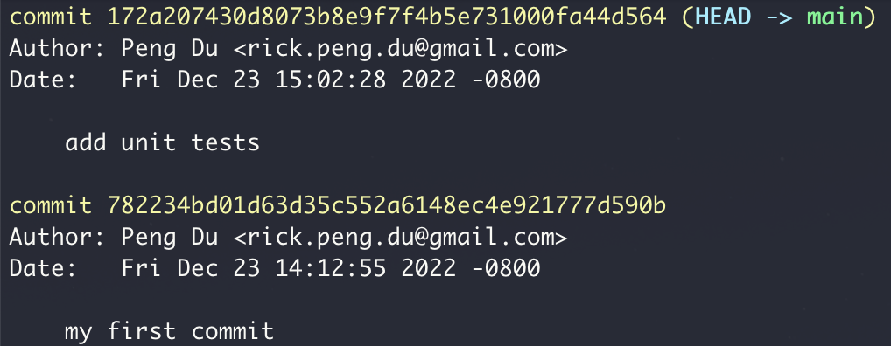
4
git log
from in command line
from IDE (CLion)
“Hey Git! Shows me the list of commits so far’”

Slide 18
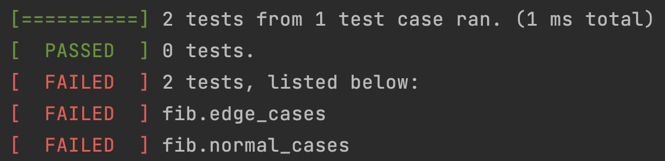
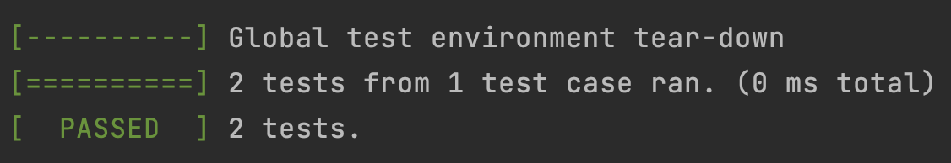
5
Write fib(int n)
git commit -am ”finish fib"
“Hey Git! Make a commit”

Slide 19
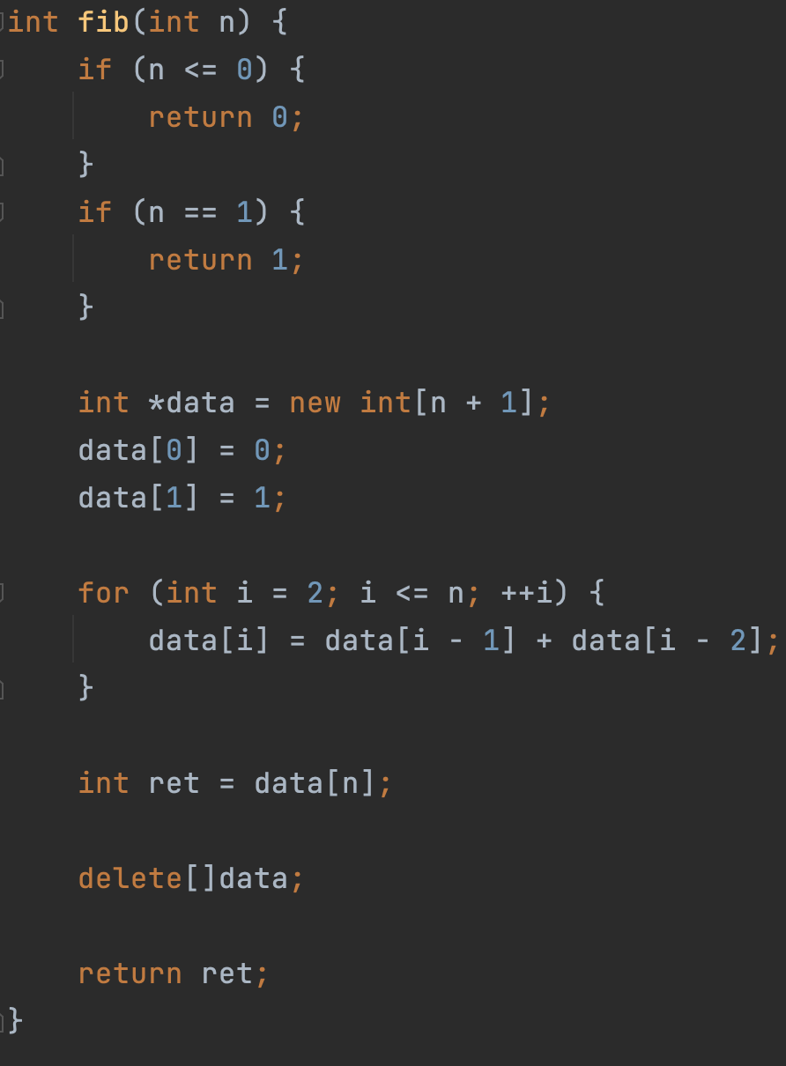

0
1
1
2
3
5
New Idea: What if we don’t use the array?

Slide 20

New idea? Test it in a new branch
Commit 1
Commit 2
Commit 3
Merge, Commit 6
Main branch
New idea branch
Commit 4
Commit 5

Slide 21
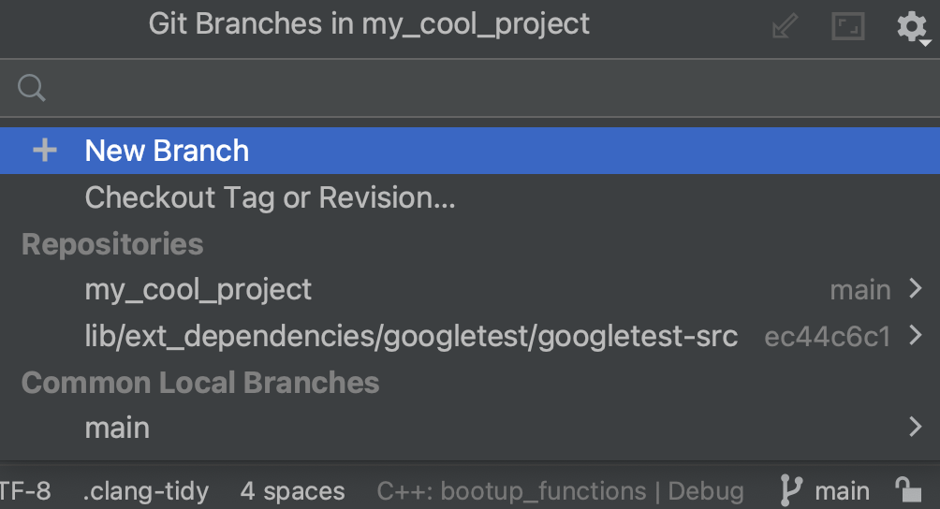
6
git checkout -b new_idea
From command line
from IDE (CLion)
“Hey Git! Create and switch to a new branch called “new_idea”

Slide 22
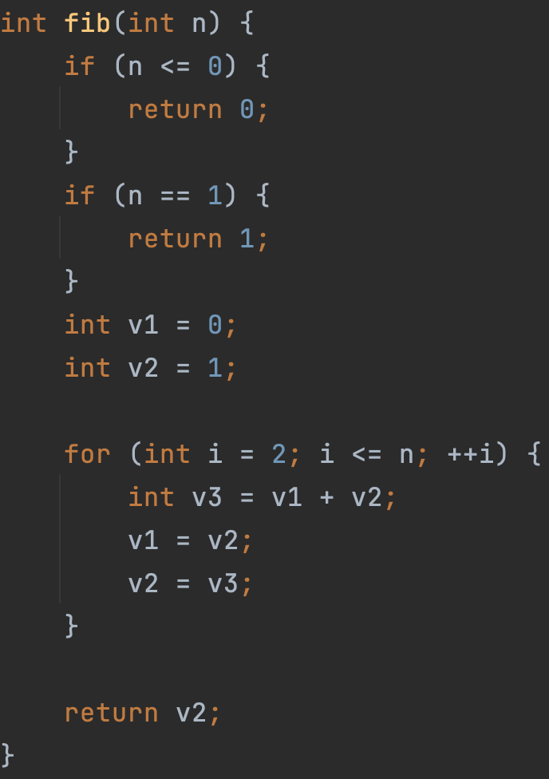
7
Write fib(int n) with new idea

Slide 23
8
git commit -am "finish fib with new idea"

Slide 24
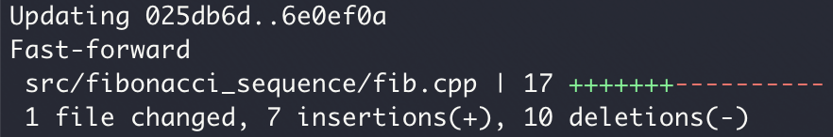
9
Merge new idea into the main branch
git checkout main
“Hey Git! Switch back to the main branch
git merge new_idea
“Hey Git! Merge the code in new_idea branch to the current branch (main)

Slide 25
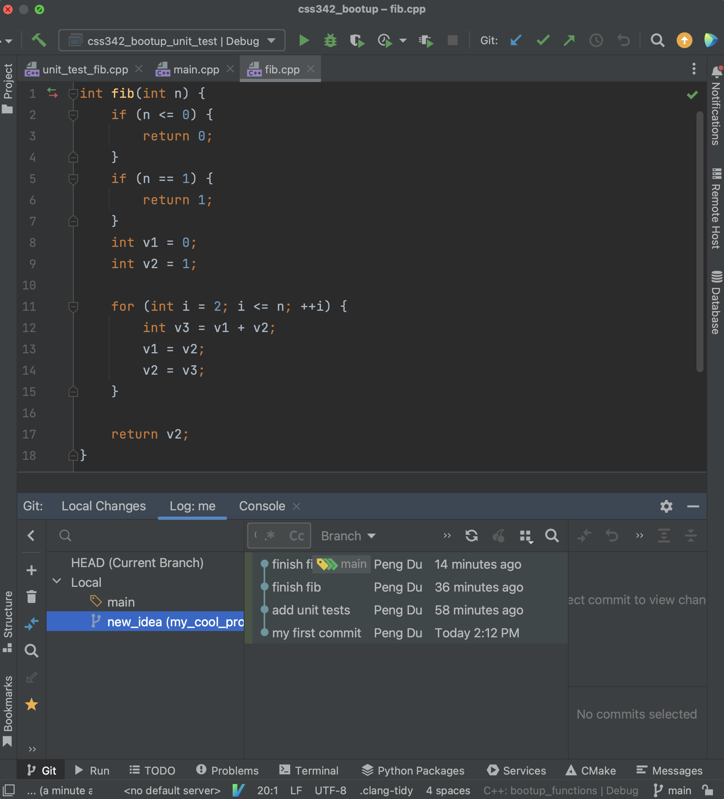
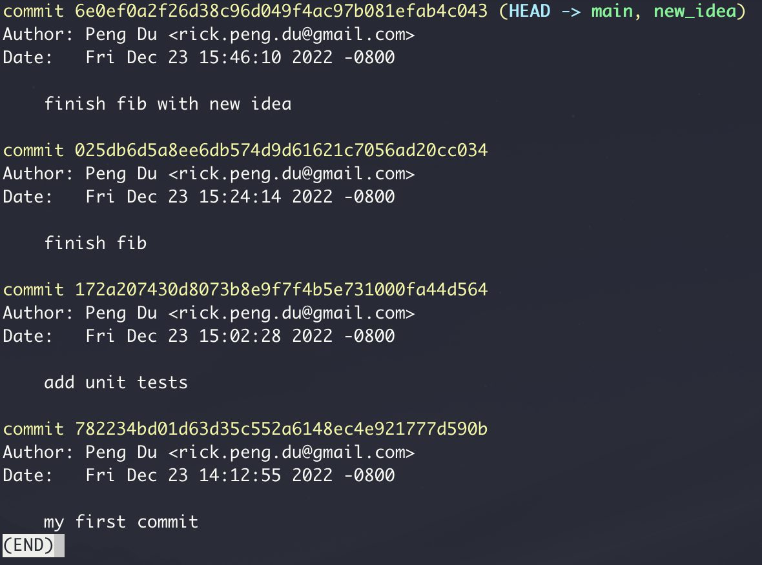
git log
from in command line
from IDE (CLion)

Slide 26
git init
git add .
git commit -am "commit message"
git diff
git log
git checkout -b new_idea
git merge new_idea

Slide 27

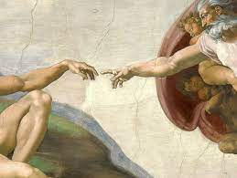


Slide 28

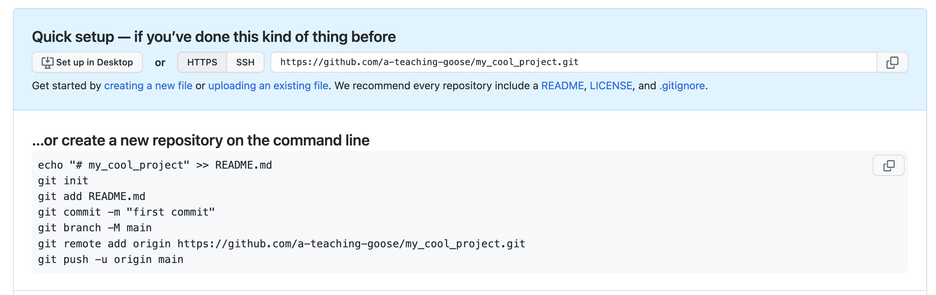

Slide 29
git remote add origin https://github.com/a-teaching-goose/my_cool_project.git
“Hey Git! Connect my local repo to a remote repo with the provided url, and I’ll use ‘origin’ on my laptop to refer to this remote repo

Slide 30

git push
“Hey Git! Push my local repo to the remote repo”
git pull
“Hey Git! Get what’s in remote repo,
and merge with what I have in my local repo”

Slide 31

git push
“Hey Git! Push my local repo to the remote repo”

Slide 32
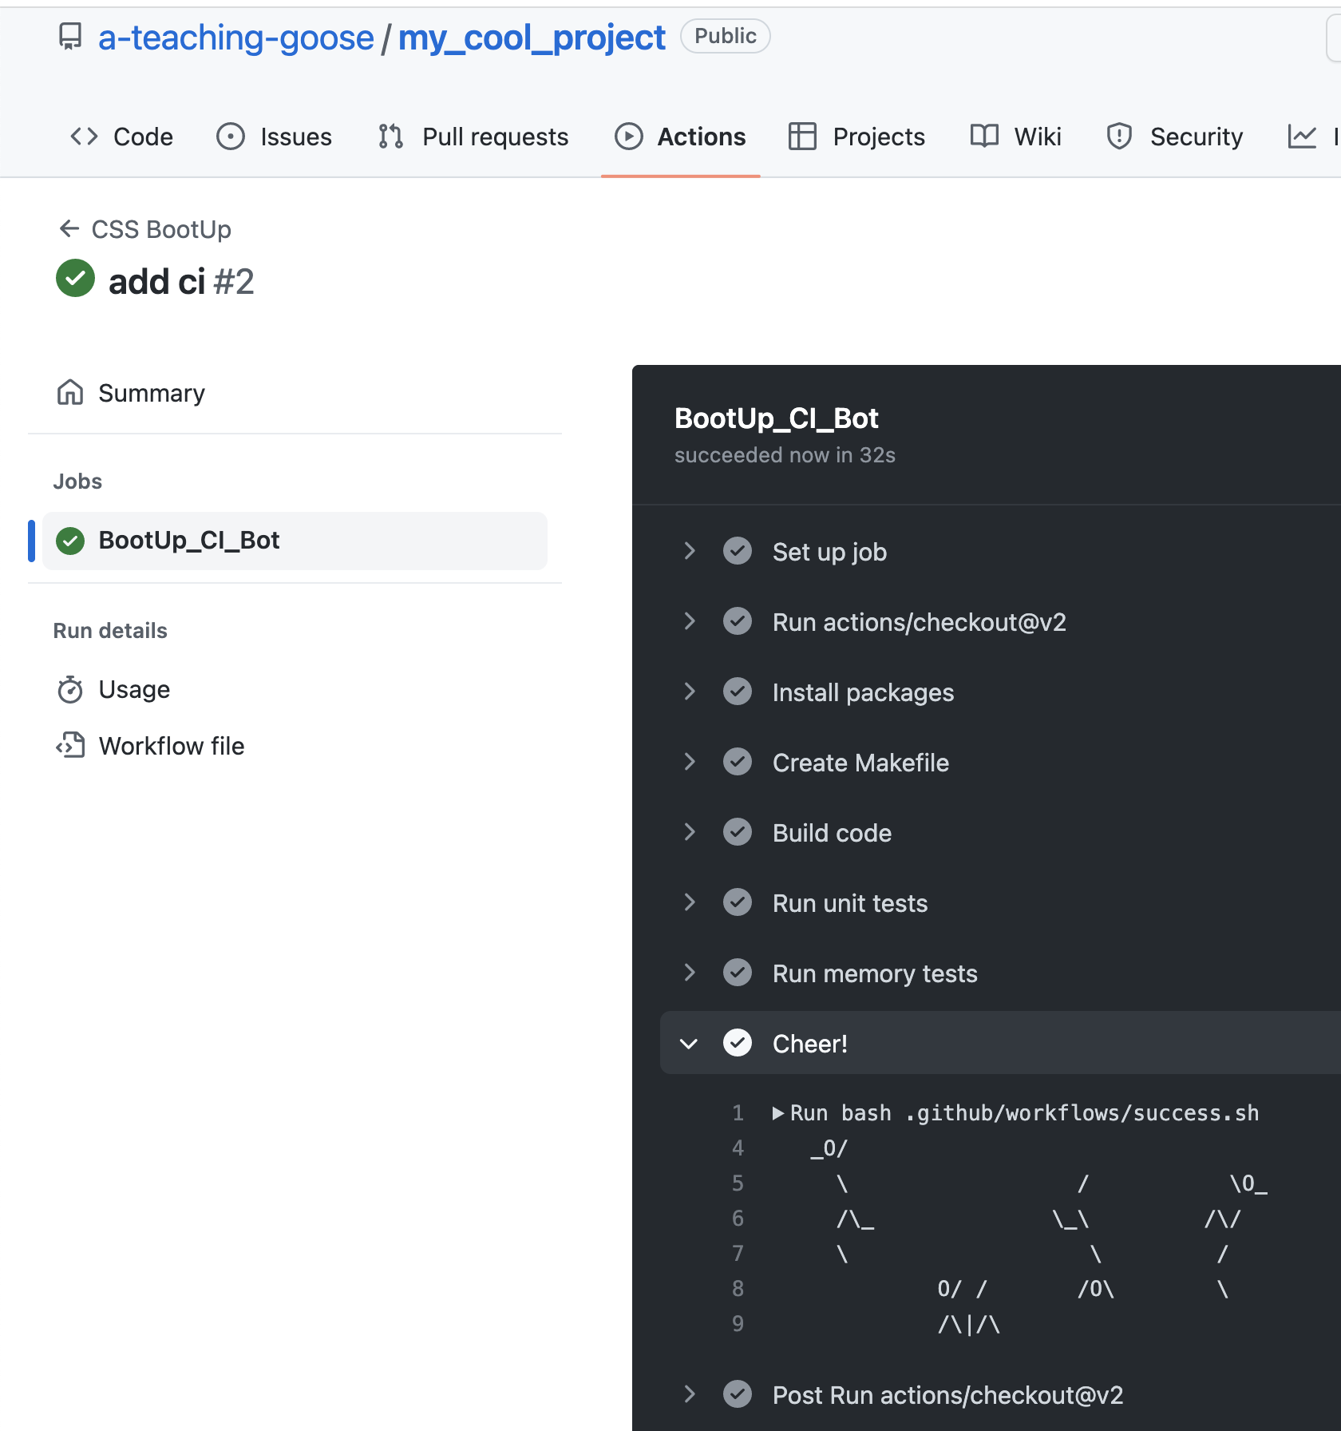
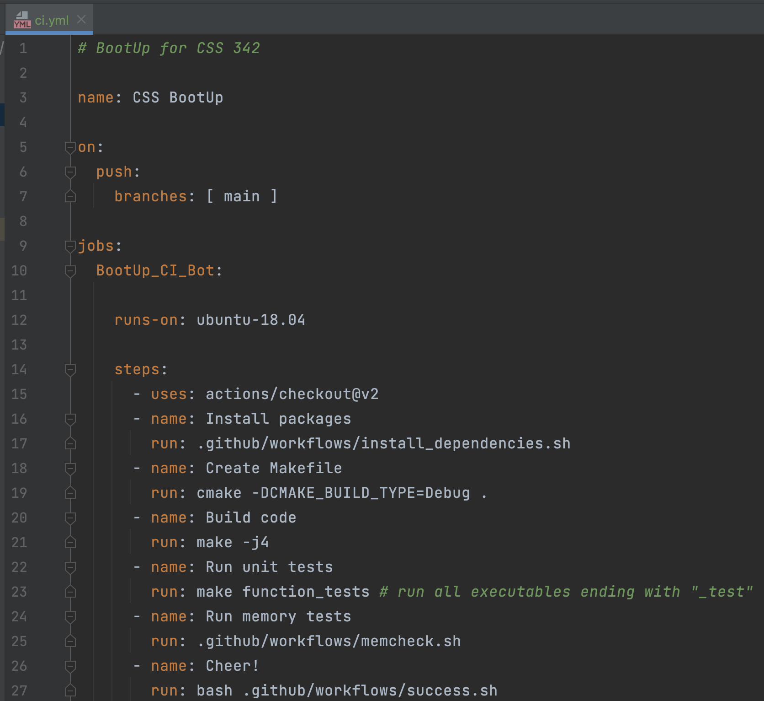
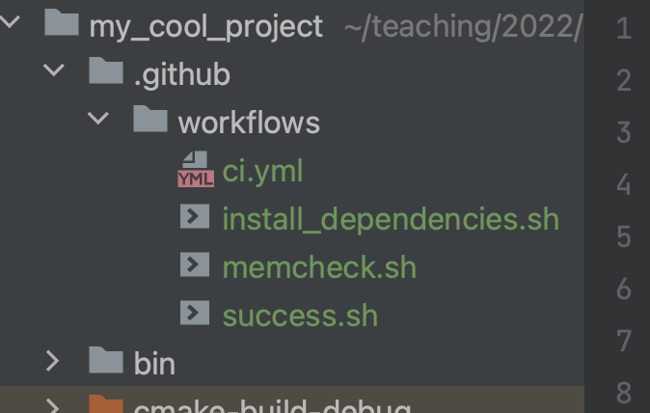
git push

Slide 33
Pull
Push

Slide 34
Remote repo
Exact Mirror
Local repo

Slide 35
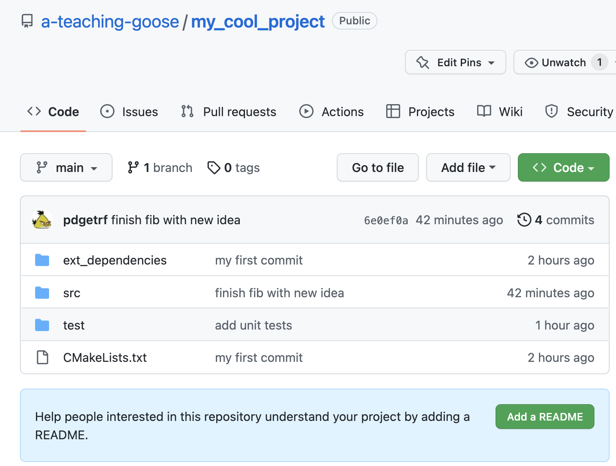
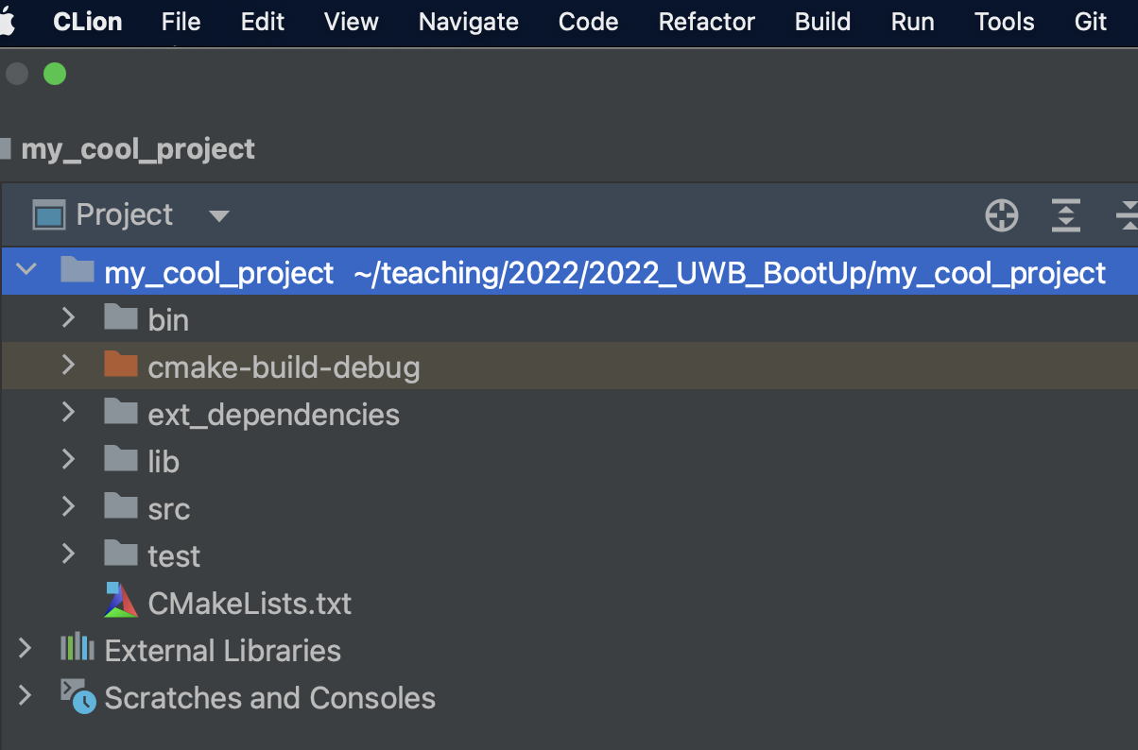

Slide 36


Slide 37
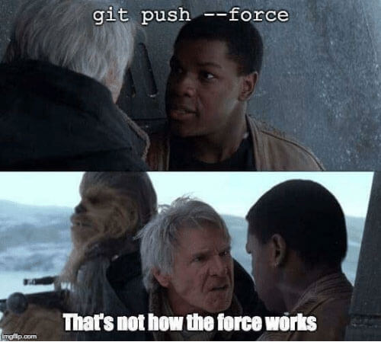
ACT II: Advanced Topics
Collaboration
Pull Request
Merge
Continuous Development
CI & CD

Slide 38

Create a pull request (for merge)
Run all unit tests
Code review by colleagues happens here
Need someone else would approve this

Slide 39
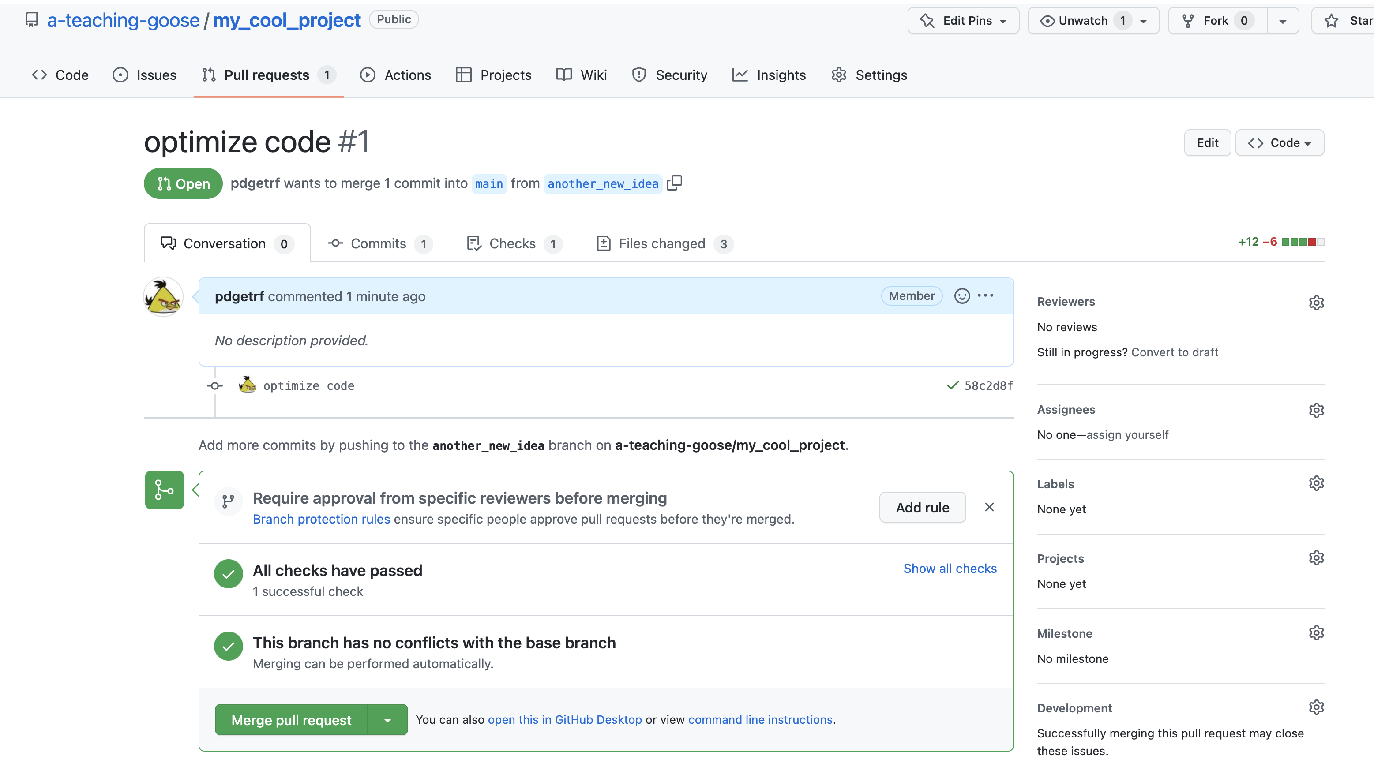
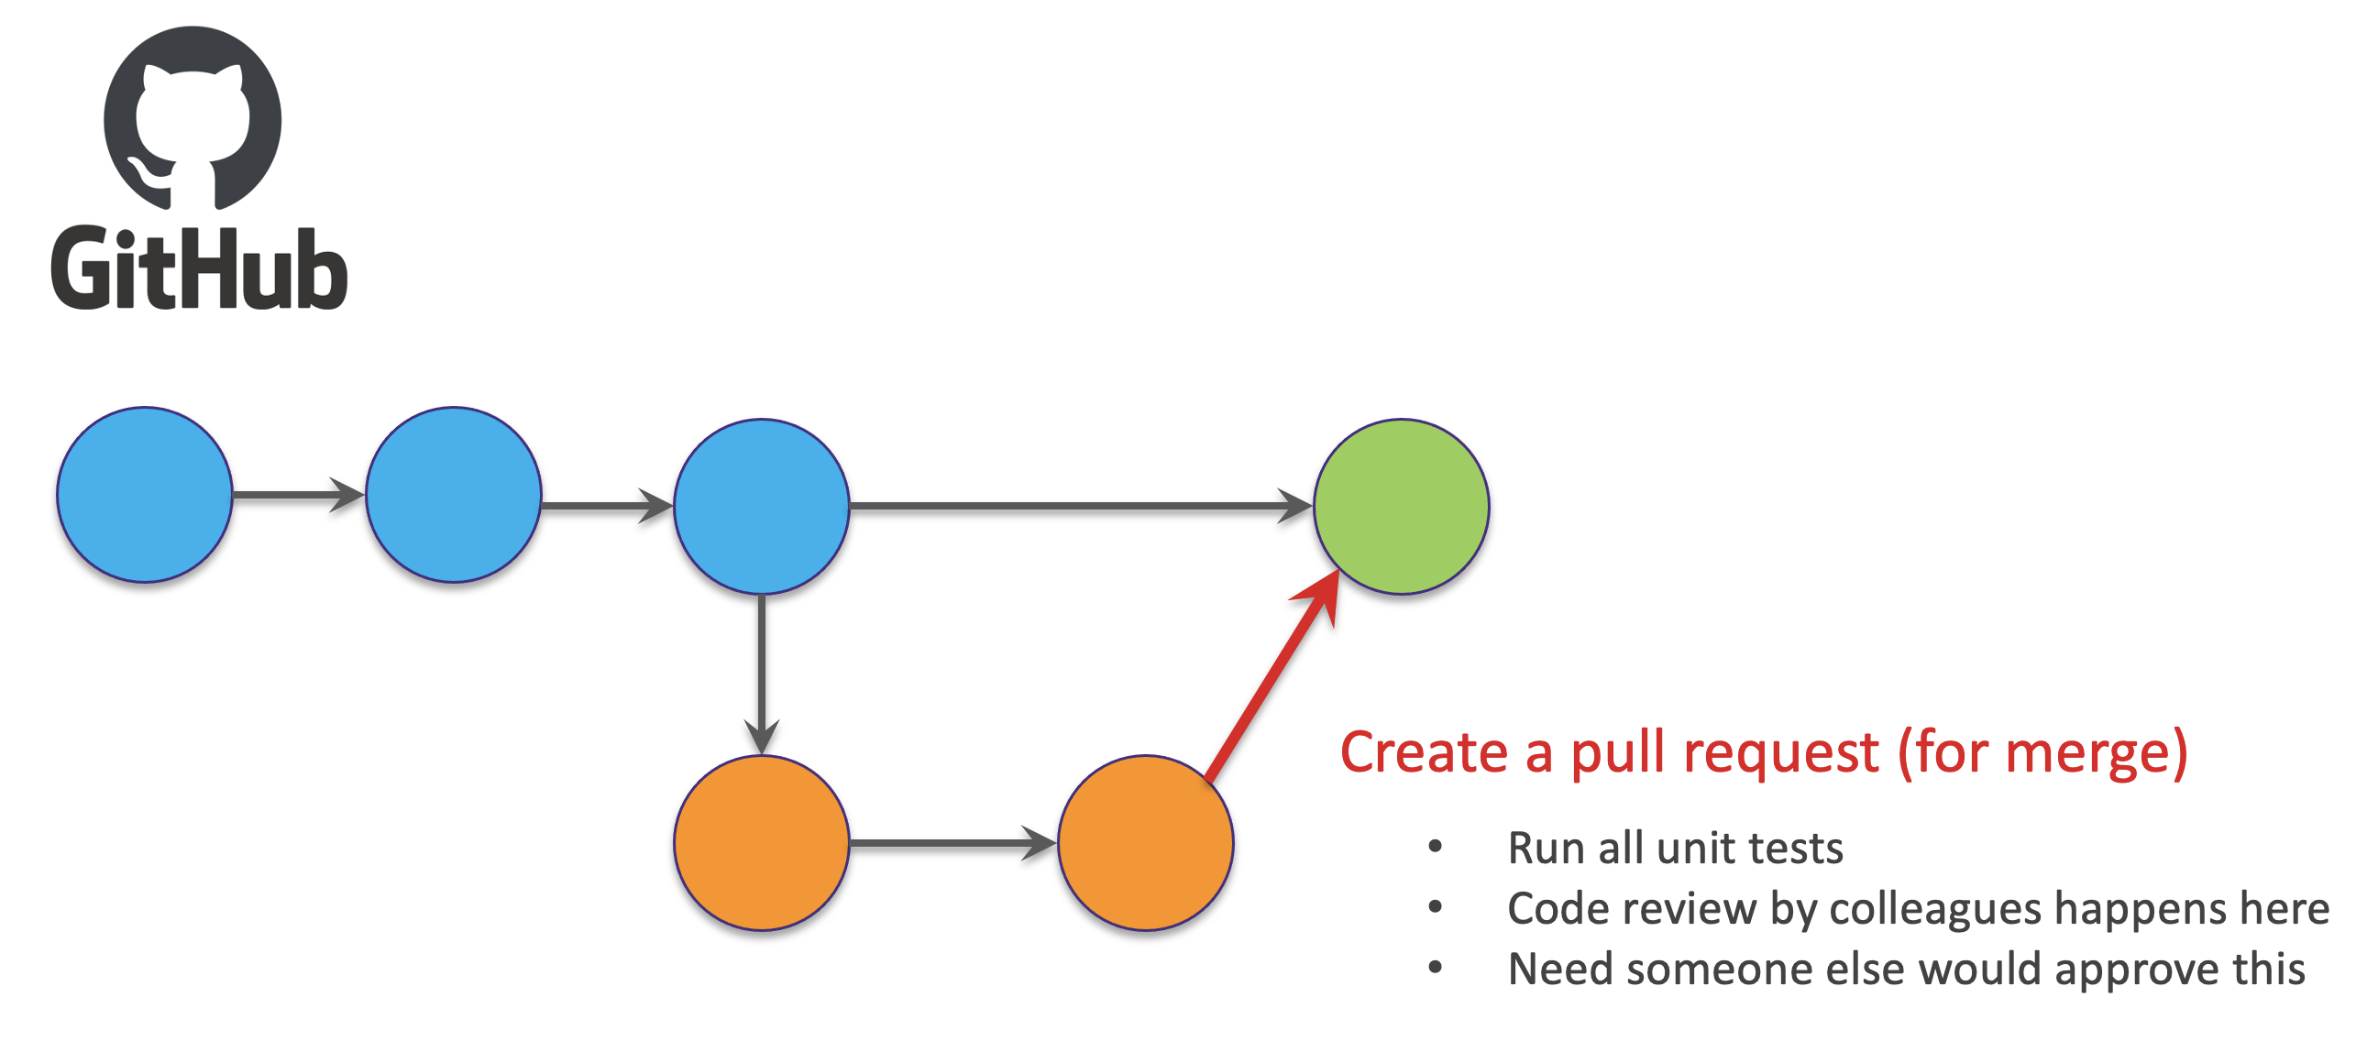
Find the finished code here

Slide 40

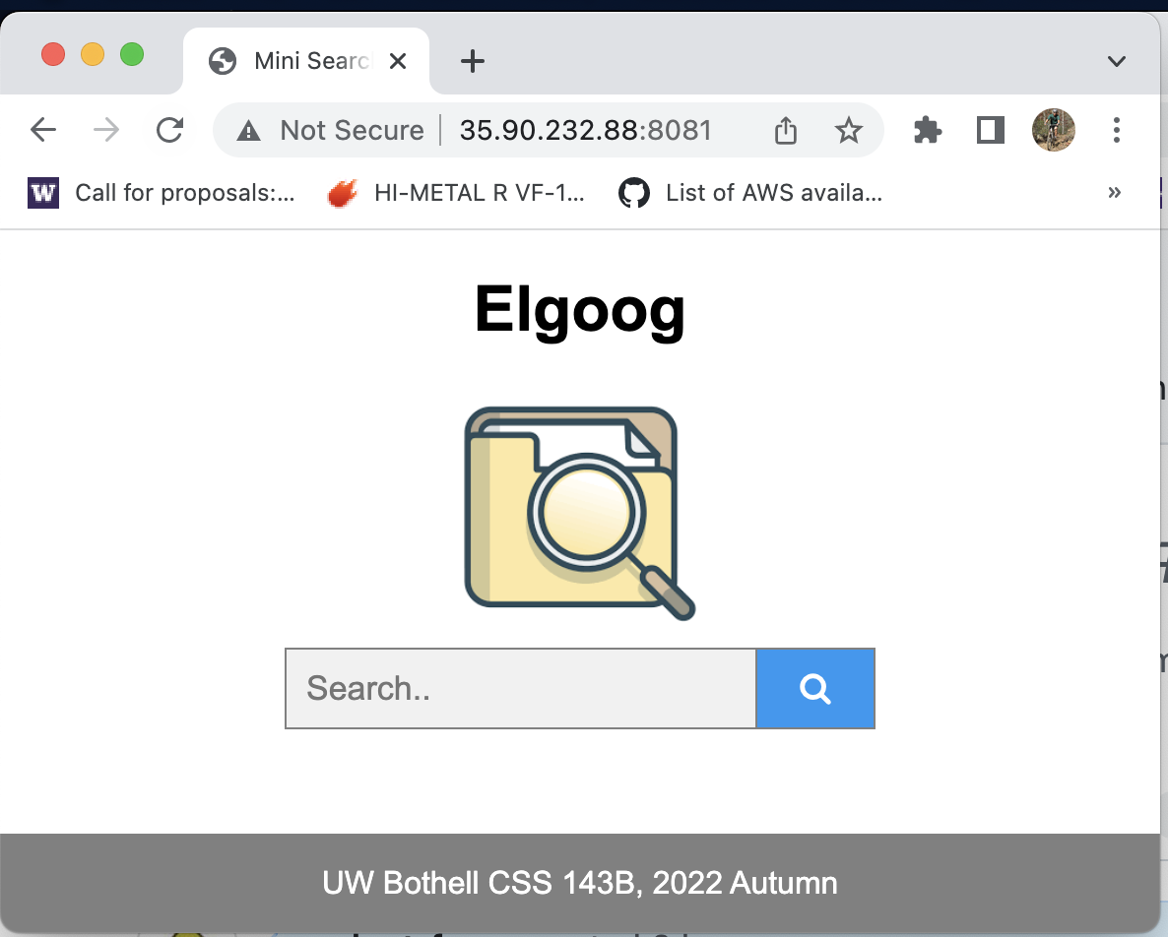

CI/CD
Clients/customers
”production site”
Tests (unit test, end-to-end test)
Your new code changes

Slide 41
Continuous Deployment Workflow (Generic)
Testing
(unit test, integration, e2e, etc.)
Staging
Production
Features &
Requirement
Coding
Git
(local)
GitHub
monitoring
Code Review
Deployment
Live Site
(updates, triage, etc.)

Slide 42
git push
git checkout -b new_idea
git pull
git merge new_idea
git init
git add .
git diff
git commit -am "commit message"
git log

Slide 43
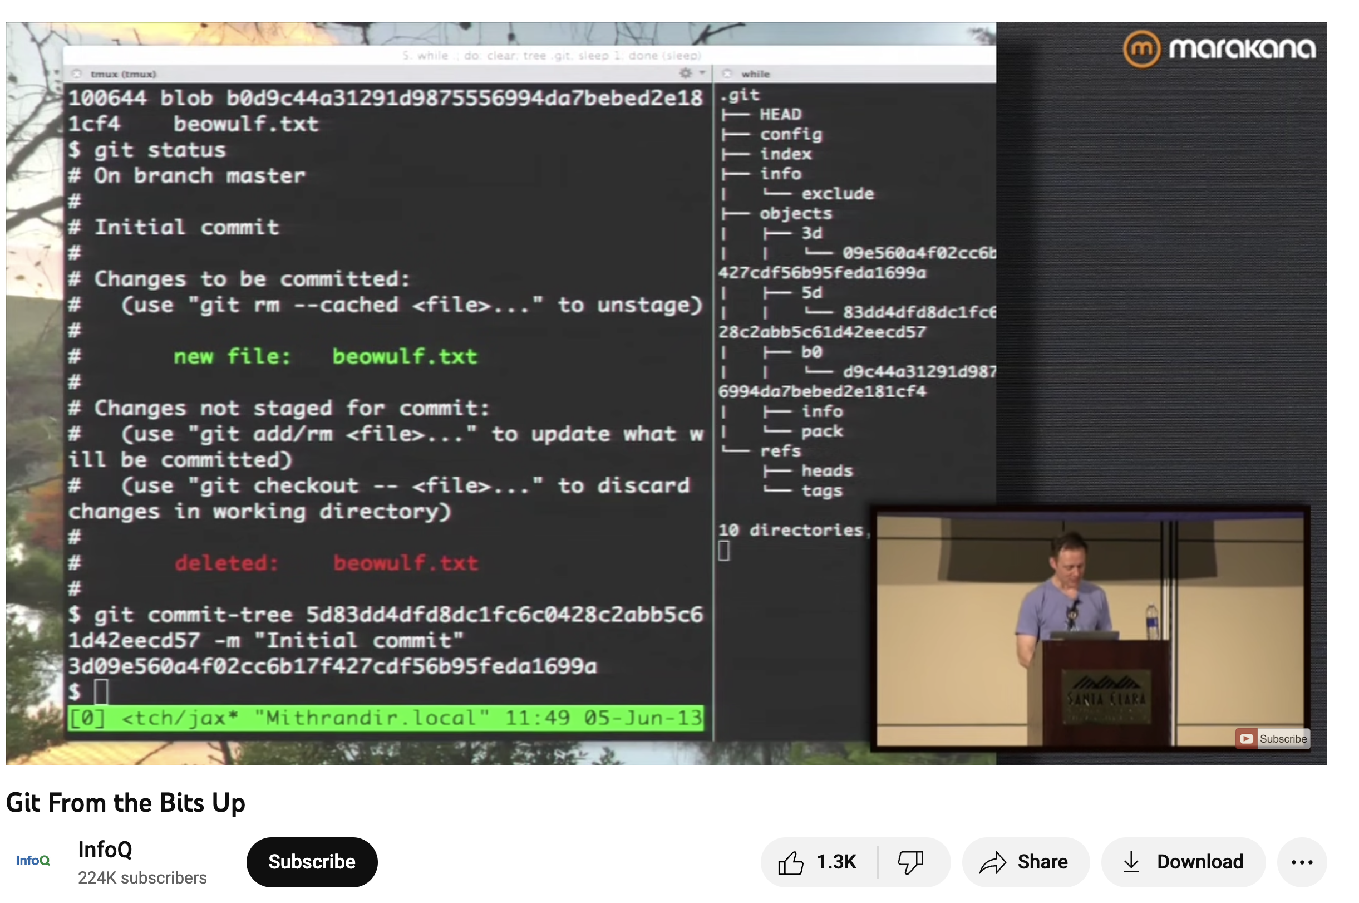
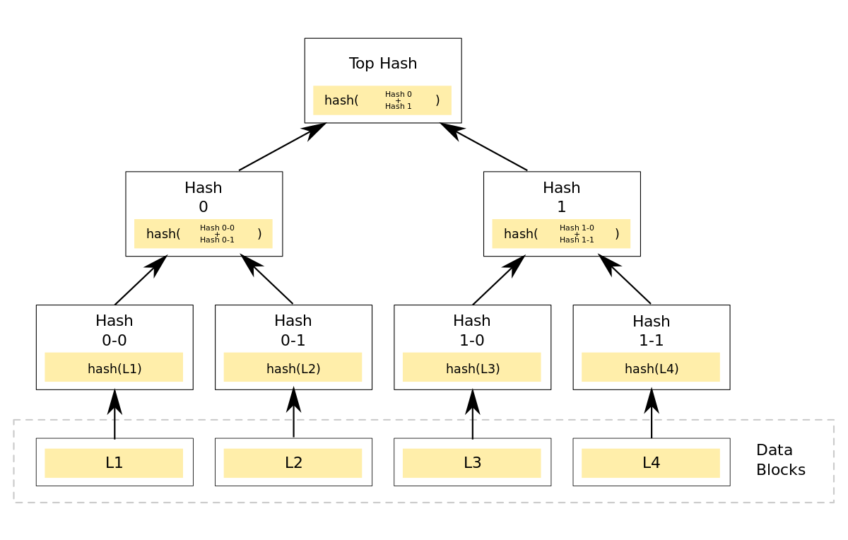
Git Internals
https://youtu.be/MYP56QJpDr4
https://en.wikipedia.org/wiki/Merkle_tree

Slide 44

#CodeSafely

Slide 45
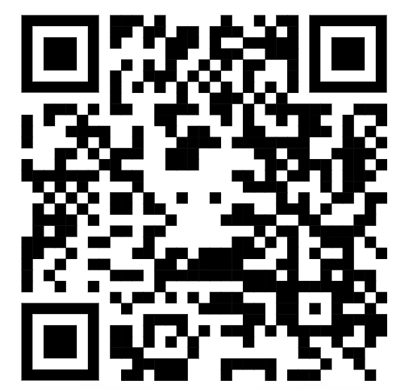
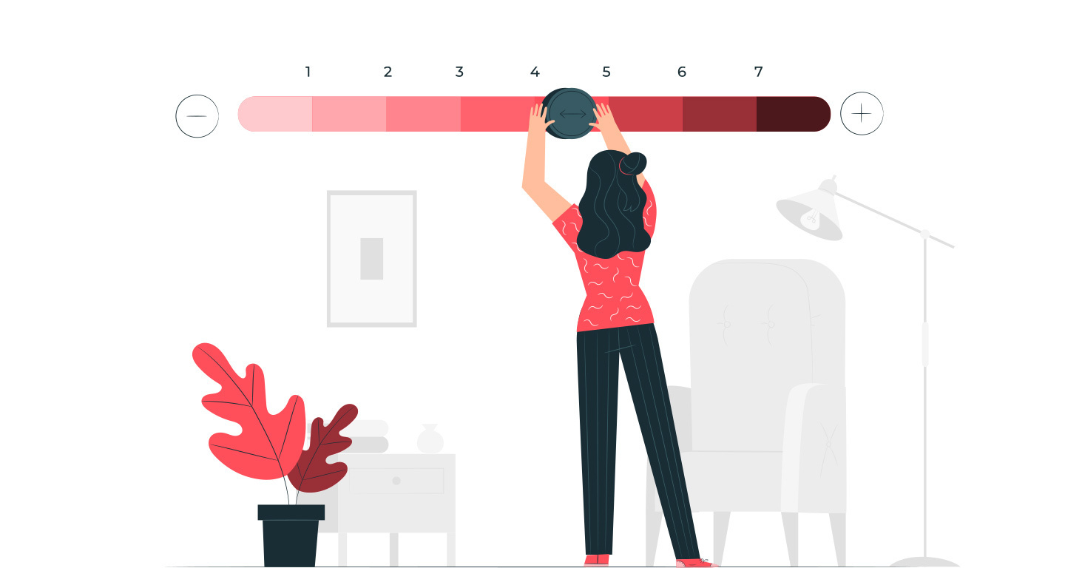
Evaluation
https://forms.gle/Vy4ZsbcDUyZ1PBDD6

